Slide 1
Modeling Cloud Ecosystems
Madiha H. Syed College of Electrical Engineering and Computer Science
Florida Atlantic University.
msyed2014@fau.edu

Slide 2
Outline
Introduction
Cloud ecosystems
Patterns and Reference Architectures
Models of Ecosystem Components
Internet of Things
Fog computing
Conclusion and Future work

Slide 3
Introduction
Cloud computing offers demand-based computing service.
Levels of service: Infrastructure as a Service (IaaS), Platform as a Service (PaaS), and Software as a Service (SaaS).
A cloud is not a single system, it comprises a multitude of systems, components, services, and applications.
Clouds usually do not work in isolation but interact with other clouds and with a variety of associated and interdependent systems.
Associated systems are either developed by the same provider or by external entities with the purpose to interact with them.
Associated systems are a growing set, where new types of products appear.

Slide 4
Cloud Ecosystems
An ecosystem is the expansion of a software product line architecture to include systems outside the product which interact with the product. (Fernandez , Yoshioka and Washizaki 2015)
Cloud ecosystem is a term used to describe the complex system of interdependent components that work together to enable cloud services.
Holistic, Unified approach reduces complexity
Useful for handling security and privacy cloud-based systems
Easier to perform analysis of the propagation of threats and data leaks.
An ecosystem is advantageous to suppliers who can offer a larger variety of products or services, and to consumers who can find more products to help them reach their business goals

Slide 5
Cloud Ecosystem
A cloud, its associated systems, providers, consumers, brokers, software, and infrastructure are all related and make up the cloud ecosystem.
The complexity of the cloud ecosystem is also increasing as new functions or technologies become available.
Growth in dimension and diversity of this ecosystem is contributing to the evolution of intelligent and interactive environments like IoT.
A convenient representation when building or using cloud ecosystems and similar complex systems is the use of architectural models based on patterns.
After building a pattern diagram with the components of the ecosystem we need to build detailed models for the components

Slide 6
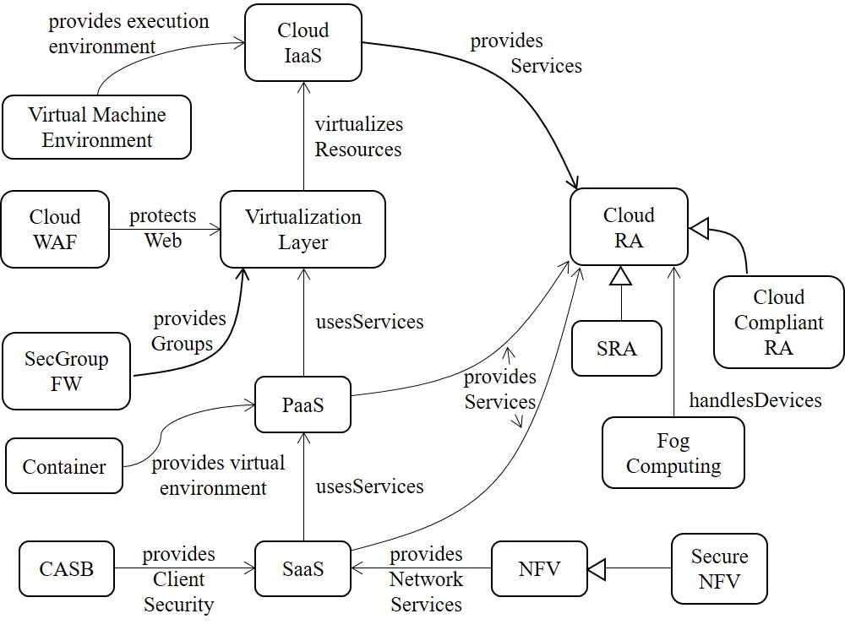
Pattern Diagram of Cloud Ecosystem

Slide 7
Ecosystem Components
The core pattern of this ecosystem is the Cloud Reference Architecture (Cloud RA) .
Addition of security patterns to a Cloud RA converts it into a Cloud Security RA (Cloud SRA). The Cloud SRA includes security patterns for Authentication, Authorization, and Logging, among others, which can help control known threats to the cloud.
Patterns that describe how regulations apply to the Cloud RA are included in the Cloud Compliant RA
Other components of the ecosystem, shown in Figure, include the service layers of a cloud, IaaS, PaaS and SaaS .
Network Functions Virtualization (NFV) is a network architecture where network functions such as load balancers, firewalls, IDS, and accelerators are provisioned in software using virtualization.
Other security-related components are also represented as patterns.
Filtering functions are provided by Cloud Web Application Firewalls (Cloud WAF) and Security Group Firewalls (SecGroup FW).
Cloud Access Security Brokers (CASBs) are security enforcement points between consumers and service providers that apply security controls to access cloud services, usually SaaS services. They may also control access to internal company resources. Security controls may include authentication (credentials and passwords), authorization policy enforcement, intrusion prevention, antimalware filters, security logging/auditing, and encryption.
New entities that have been added to this ecosystem include Containers, Virtual Machine Environment and Fog Computing.
Notes:
Network Functions Virtualization (NFV) is an architecture for the construction of services using software building blocks that can be used to assemble network systems. The building blocks, Virtual Network Functions (VNFs), are created from cloud software services.
SOLUTION
Service providers (SPs) can use SaaS services to provide network functions where we simulate the specific functions of a hardware device using software running in one or more virtual machines or containers in the cloud. We can build network services using the PaaS and IaaS services and deploy them as SaaS services. These network services can then be used for the needs of the applications being accessed by the Consumers.

Slide 8
Patterns and Reference Architectures
A pattern is a solution to a recurring problem in a specific context.
They encapsulate the experience and knowledge of designers, provide a larger unit of reuse, and a communication vocabulary for designers.
Usually, a template with predefined sections is used to describe patterns.
POSA (Pattern-oriented software architecture) template.
A Reference Architecture (RA) is a generic and abstract software architecture that applies to a particular domain and does not contain implementation details.
It specifies the components of the system, their individual functionalities and their mutual interaction.
An RA can be considered as a compound pattern and its components described as patterns.
Notes:
A Reference Architecture (RA) is a generic and abstract software architecture that applies to a particular domain and does not contain implementation details.
It specifies the components of the system, their individual functionalities and their mutual interaction.
An RA can be considered as a compound pattern and its components described as patterns.

Slide 9
Models of Ecosystem Components
Software Containers
Virtual Machine Environment
Fog Computing
Notes:
-A pattern diagram for cloud ecosystem gives a holistic and unified view and the next step is to define detailed models for each of its components.
-Some of these components have already been described as patterns,
-here we include patterns for two components which were not present in our earlier work
-Complete patterns can be found in their respective references, just main functions of the components are included here.
Pattern descriptions also include Forces, Consequences, Implementation, and Related Patterns sections.
The idea here is that we can build patterns for every participant in the ecosystem, which provides a unified view of the complete system.

Slide 10
Fog Computing
Recent popularity of IoT has made fog computing a necessity
It is an advancement in Cloud Computing paradigm
Complement rather than replace
Fog computing is an important part of cloud ecosystem
It brings virtualized cloud services to edge of the network
It provides computing, storage, networking services between end devices and cloud data centers
Efficient, location aware, close to the edge, cloud services.
POSA template was followed to develop this pattern

Slide 11
Internet of Things
The IoT has found its application in various domains.
The IoT has brought about an explosive proliferation of endpoints.
According to an estimate, nearly 50 billion heterogeneous devices will be connected to the internet by 2020.
Storage and processing costs are declining and the devices are getting smaller and less expensive.
Increased intelligence of these devices
Huge amounts of data
90% of the world’s data was created in the last 2 years, and it is increasing exponentially.
We need to manage the large number of devices and process the data produced by them.
IoT is already here
We need for new technologies (networking and analytics)

Slide 12
Applications
Smart Traffic Control
Smart Grid
Wireless Sensor networks
Precision Agriculture
Intelligent Buildings
Health Care
Industrial Automation
Oil and Gas
and more…

Slide 13
Internet of Things
IoT applications typically require low latency, support for heterogeneity, mobility, geographical distribution, location awareness, etc.
Popularity of IoT has made the limitations of clouds more apparent, We need new solutions.
Cloud service providers like Amazon, IBM, Cisco, etc., are offering solutions to cater to IoT systems.
Fog computing offers one of such solutions.
It complements rather than replaces the cloud.
Numerous papers discuss these IoT applications in connection to fog computing. Ours is the first pattern for fog computing.
Containers are also providing more lightweight, portable virtualization solutions that will offer support for IoT applications.
Notes:
Cloud computing has established itself as a promising computing paradigm. However, the recent p

Slide 14
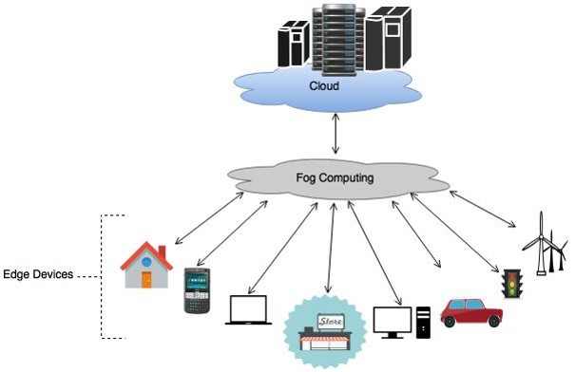
Fog Computing Pattern
Intent: Fog Computing is a virtualized platform that stands between cloud computing systems and Internet devices, providing to these computation, storage, and networking services and allowing a cloud to control and communicate with these devices and to the devices to perform some functions in the fog or the cloud.
Also known as Fog networking, Fog, Fogging, Edge of network computing, Edge Computing, Mobile-edge computing
Figure 1: Idea of Fog Computing

Slide 15
Example: Smart Traffic Control System
Smartville has a Smart Traffic Control System.
It is comprised of many heterogeneous devices like traffic lights, vehicles, emergency vehicles, and pedestrians with mobile devices.
Each device has a diverse set of resources and data.
The number of devices that are connecting to the Internet is growing rapidly.
The devices are becoming smarter and the need for more applications is ever increasing.
We are finding it difficult to manage and coordinate these devices.
Service and application requests from the cloud need to be processed in real time to control these devices.
With a large number of devices the volume of data produced is huge. It is a challenge to transmit this dynamically-produced data to cloud centers, analyze it and provide useful results in real time.
In order to provide safe and efficient transportation through this system we have to find a way to detect problems and provide real time traffic information to the users, control traffic lights to create green waves, etc.
These scenarios require us to take into account their location as well.

Slide 16
Context
The Internet of Things comprises large numbers of smart devices at the network edge that may have to collaborate and interact with each other in real time.
There is an ever increasing number of devices and they are usually handled by a cloud.
The devices, which are connected to the Internet and the cloud, are becoming more intelligent and more heterogeneous.
These devices are distributed over vast geographical areas and generate huge amounts of data.
The IoT environment predominantly supports wireless access and mobility.
In addition, the IoT often requires a multiplicity of service providers [Bonomi et al. 2014].

Slide 17
Problem
How do we provide compute, storage and networking services efficiently to applications running on IoT devices?
Since IoT is becoming increasingly popular and we have a growing number of heterogeneous smart devices connected to the Internet.
The cloud usually provides support in these situations, however, cloud systems find it increasingly difficult to handle these devices.
The applications running on these devices can produce a huge amount of data. Given the limited available bandwidth, it is difficult to transmit this data to the cloud, process it and return actionable results in real-time.
In addition to volume of data and number of devices, wireless connectivity, mobility and geographical distribution make it difficult to get required services directly from the cloud.
Cloud data centers are few in number and are sparsely located whereas devices are more widely distributed.
The available bandwidth is limited and data transmission to the cloud data centers becomes a bottleneck.
Two major problems that IoT application faces when working with clouds are latency and bandwidth limitation. Moreover, to preserve the confidentiality and integrity of the data we also need to be able to apply policies for accessing and filtering the information.
Notes:
IoT = growing number of heterogeneous device + huge amount of data + real time action

Slide 18
Forces
Large number of nodes: Many devices are part of the networks and these nodes produce data which has to be collected and analyzed.
Latency: Many applications run on devices at the edge of the network, which means they are at a distance from the few and far located cloud data centers. Cloud computing supports centralized remote provisioning of resources which can introduce delay. Some of these applications can be latency sensitive and we want the latency to be as low as possible; otherwise, we could use cloud computing.
Mobility: We want mobility support because many devices in the edge of networks are not stationary; for example, vehicles or people with smart devices. This should not affect the accessibility or efficiency of the system.
Location awareness: End users may require applications that are aware of device location. For example, devices like smart traffic lights, vehicles and others. The information required by these applications can be specific to their geographical location. The cloud offers more global and centralized services and it can be difficult for cloud systems to maintain this level of location awareness with devices that are mobile and geographically distributed.
Heterogeneity: Different devices that are part of the Internet of Things can have diverse specifications like routers, switches, access points, end user devices, and we have to support and manage them in a uniform and consistent way.
Notes:
The solution to this problem is guided by the following forces:

Slide 19
More forces..
Transparency: We do not want the users to be concerned about the storage, communication or computational limitations of their devices. Resource provisioning for the devices has to be transparent.
Big data analytics: The volume of data produced by all edge devices is huge and it is impractical to transfer it to centralized data centers and analyze it there. When cloud provides all data analysis of IoT applications, it leads to inefficient bandwidth utilization and latency. There is a need to process a large part of the data being produced by the devices to provide results in real-time or almost real-time.
Cloud support: In order to provide low latency and location awareness we want a solution which is closer to edge devices but more permanent storage may be needed and long term computations might still have to be performed in cloud data centers. Interaction with the cloud has to be supported.
Scalability/Flexibility: Resources and devices should be added dynamically to accommodate constant change.
Multi-tenancy: Multiple applications have to be supported which requires resource sharing. We need multi-tenancy support in the computing platform which supports IoT applications. This may result in performance and security problems.

Slide 20
More forces..
Multiplicity of providers: IoT applications require support for a multiplicity of providers. IoT systems are distributed and it is likely that the system may extend beyond the boundaries of a single controlling authority, owner or provider. This requires the orchestration of consistent policies across multiple providers [Bonomi et al. 2012].
Security: The devices may need to access shared databases in the cloud and we need to apply access control to this data, which also requires identity and authentication. Some devices may need even finer access control. We also need to control access to devices, in addition to access control to fog data and cloud data.
Filtering: The volume of data produced by the edge devices is huge. All of this data may not even be required by the cloud to provision required services; infact, some data may be unnecessary or even potentially harmful if it is sent to the cloud. This can cause security issues and inefficient bandwidth consumption.

Slide 21
Solution
Introduce a platform to provide cloud computing-like services closer to the devices to be monitored or controlled. This is called Fog Computing.
It provides computation, storage, and networking services between end user devices and cloud providers.
Fog Computing can offer low latency, location awareness, efficient use of bandwidth and storage services.
Data is processed locally for more immediate response.
Aggregated data and other relevant information can be forwarded to the cloud for analysis.
In addition, services like security, filtering, etc., can be provided by the Fog.

Slide 22
Solution
Edge devices are smart devices which have Internet connectivity; for example, smart phones, tablets, laptops, traffic lights, vehicles, homes devices, etc.
The Fog acts as an intermediate layer between the Edge Devices and the Cloud.
Edge devices request compute, storage and communication services from the Fog.
The Fog provides local, low latency response to these requests and forwards relevant data for computationally intensive processing, long term analytics and persistent storage over to the cloud.
There are many edge devices, a Fog Computing platform manages and controls these devices and the cloud providers are relatively fewer in number.
Size, storage capacity, processing capabilities, and latency increase as we move upward in the system.
Figure 1: Idea of Fog Computing

Slide 23
Structure
The Fog is a collection of several distributed tiny clouds called Fog Nodes. They can be resource-rich servers, routers, access points, mobile devices etc.
A Fog Node has resources including hardware (compute, networking and storage) capabilities. These nodes provide local real-time data analytics capabilities using an Analytics Engine.
Applications can be hosted in the fog nodes using virtualization, Virtual Machine Monitor (VMM), Virtual Machine (VM) and/or Containers.
A database stores both application data and necessary metadata for service orchestration. It also has information about hardware and software capabilities of nodes, information about the state of fog nodes and services, policies for security, filtering, and configuration.
Fog computing uses Reference monitor to perform policy-based service orchestration.
A Policy Manager is triggered by service requests and a Decision Maker Engine (Reference Monitor) gathers relevant policies and metadata to decide about requests. Also, depending on the information received, new policies can be added to the Policy Repository [Dsouza et al. 2014].
Data is transferred between fog nodes, the decision maker and the various components of the Fog.
Reference monitor enforces the authorization rules and authenticator is used for providing access control.
In addition, services like filtering, aggregation of data, logging, etc., can be provided.

Slide 24
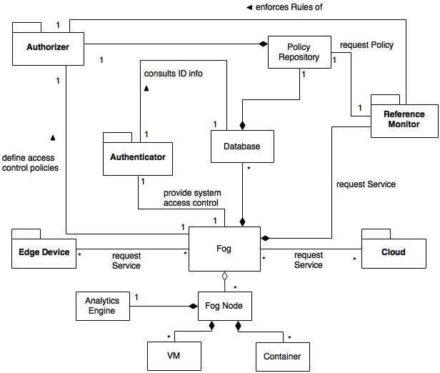
Class Diagram for Fog Computing Pattern

Slide 25
Implementation
Fog computing requires multi-tenancy support for applications, from different software companies or developers, that need to execute without interfering with each other. So, the cloud platform in devices comprising the fog platform should support multi-tenancy for applications.
Despite multi-tenancy fog devices should be able to execute applications in isolation to prevent unwanted interference from other processes.
Policies have to be defined to control service orchestration, filtering and for adding security.
Decentralized management mechanisms need to be established to setup and configure a large number of devices in fog [Vaquero and Merino 2014].

Slide 26
Implementation example: Cisco Fog Computing
Cisco Fog Computing with IOx can be used as an example of implementation of fog computing.
Cisco IOx allows data analysis and command processing at edge of the network using “Cisco Data in Motion”, “IOx middleware analytics” and “policy engine” [Cisco 2015]. Information is aggregated and filtered before sending it to the cloud. This conserves storage and bandwidth.
Cisco IOx provides IoT application development and deployment with its SDK and middleware services. It also enables application hosting through infrastructure called “Application Enablement Platform”. It also supports mobility between cloud and fog. In addition to this, Cisco provides application monitoring and management services for application deployed in the Fog.
Each individual fog is assigned to a specific area like clouds have zones. So selecting a fog implies selecting a specific area, this makes locations awareness implicit part of fog computing. For example, if a router is used as a fog node it would have a particular location. In addition to this, Cisco IoT solutions offer Connected Mobile Experiences (CMX). These solutions triangulate device location using wifi and track location via device's mac address/IP address/Username if it has been registered.
Analytics engine in solution refers to the local analysis capability of fog nodes. However, analysis needs of applications can vary so it added as a service and configured as part of application to meet particular needs. For example in case of Cisco, Data in Motion is being built into Cisco solutions and using a restful API it can be built into applications. It is configurable by these applications to analyze data like we can use it to find specific data, summarize it, process it, perform other application defined analysis, etc.
More details at “https://developer.cisco.com/site/iox/documents/developer-guide/?ref=fog”

Slide 27
Known Uses
Cisco IOx provides a fog computing solution which enables users to host OS and applications at the edge of the network [Cisco 2015].
Foghorn Systems provides products for industrial IoT applications. They offer real-time analytics at the edge of the network. Foghorn technology platform includes analytics engine for fog computing called Complex Event Processing (CEP) engine and a Domain Specific Language (DSL) to apply rules on the huge amount of the incoming sensor data streams. Aggregated data can be sent to cloud using publishing functions or used for action at edge devices. It also provides SDK for developing edge applications [Foghorn 2016].
PrismTech's Vortex provides both fog and cloud computing solutions. It provides real-time Device to Device (D2D) and Device to Cloud information sharing [Vortex 2015].
ParaDrop is a new fog computing architecture on gateways, which uses home routers or WiFi access points) that can host the platform. This platform can be used by developers to design containers based on LXC [Willis et al. 2014].
In addition to these, other IoT solutions also have similarities to the solution discussed here. Amazon Web Services (AWS) launched its Amazon IoT cloud service for IoT [Amazon 2015]. IBM also provides Watson IoT Platform on IBM Bluemix [IBM 2016].

Slide 28
Consequences (advantages)
Large number of nodes: Fog computing can offer densely distributed data collection points so it is easier and more efficient to handle this data locally.
Latency: Fog platforms are closer to the end user device and therefore they offer low latency.
Mobility: Fog computing can support mobile devices with densely and widely distributed fog nodes.
Location awareness: Being closer to the network edge, Fog computing has location awareness. This enables applications to provide services better suited to user and device location.
Heterogeneity: Fog can support heterogeneity of IoT devices by having an abstraction layer to provide uniform programmable interface for managing resources and controlling the devices [Bonomi et al. 2014].
Transparency: End users are not burdened with resource limitation; for example, storage or computation limitations. The Fog computing platform will take care of “how and where to provide these services”. Policy based orchestration functionality is provided by the fog platform in distributed fashion. If user needs more resources it will be provisioned by a fog node which has the required capabilities.
Big data analytics: Fog computing allows data collection and analytics.

Slide 29
Consequences (advantages)
Cloud Support: Immediate data processing needs can be fulfilled using fog computing; however, it does not substitute the cloud, rather complements it. Aggregated data is sent to cloud data centers for further processing
Scalability/Flexibility: Fog computing supports dynamic addition or removal of devices.
Multi-tenancy: Resources available on Fog devices can be shared between multiple applications.
Multiplicity of providers: Fog devices can be owned by different providers which are coordinated from the fog platform [Bonomi et al. 2012].
Security: Authentication and authorization services can be provided by the fog platform. Access to the user devices, fog devices and the cloud can be controlled. Fog platform can act as a reference monitor and perform policy-based control.
Filtering: Information can be filtered before it is part of the cloud to ensure effective utilization of bandwidth. Instead of transferring all data generated by the devices, only processed and aggregated data will be passed on to the cloud. Unnecessary or potentially harmful information can be removed before it is exchanged with the cloud. This not only protects the cloud but also adds privacy as far as origin of data is concerned.

Slide 30
Consequences (liabilities)
Use of fog computing means device users will have less control over selection of fog service providers as compared to the cloud. A limited number of providers are involved in service provisioning in the case of clouds. However in the case of fogs, smaller fog servers will be larger in number and will be owned by different providers. Trust and security will most likely be more difficult to establish.
Devices are now sharing resources in a more distributed environment. The confidentiality of the users can be a concern and mechanisms have to be adopted which provide authentication and authorization for ensuring user privacy. Authentication and authorization will be required at three levels: user devices, fog device and cloud providers. Policies must be mapped between these levels. [Stojmenovic and Wen 2014] discusses security and privacy issues in fog computing.
A multiplicity of providers may also lead to compliance problems, especially when health or financial data is involved.
Fog computing should support multi-tenancy which can bring a potential security problem unless strong isolation is ensured between these applications.
Heterogeneous mobile devices that are geographically distributed over a large area and are owned by different providers, could make management and configuration a problem as compared to the cloud where a centralized approach is used.

Slide 31
See also (related patterns)
Patterns for Cloud Computing Architecture [Fernandez 2013]: Infrastructure as a Service (IaaS), Platform as a Service (PaaS) and Software as a Service (SaaS).
Cloud Security Reference Architecture [Fernandez et al. 2015a] describes a security cloud reference architecture.
Virtual Machine Operating System [Fernandez 2013]. Virtual machines are used to execute multiple operating systems with strong isolation between them.
Software Container Pattern, lightweight isolated execution environment for application sharing same host OS [Syed 2015].
Authenticator pattern [Fernandez 2013] allows verification of identity of subject intending to access the system.
Authorization pattern [Fernandez 2013] describes who is authorized to access specific resources based on their identity, in a system.
Reference Monitor [Fernandez 2013]. In a computational environment in which users or processes make requests for data or resources, this pattern enforces declared access restrictions when an active entity requests resources. It describes how to define an abstract process that intercepts all requests for resources and checks them for compliance with authorizations

Slide 32
References
Amazon. 2015. How the AWS IoT Platform Works. Retrieved February 15, 2016 from https://aws.amazon.com/iot/how-it-works/
Cisco. 2015. Cisco Fog Computing with IOx. Retrived August 8, 2015 from http://www.cisco.com/web/solutions/trends/iot/cisco-fog-computing-with-iox.pdf
Clinton Dsouza, Gail-Joon Ahn, and Marthony Taguinod. 2014. Policy-driven security management for fog computing: Preliminary framework and a case study. In IEEE 15th International Conference on Information Reuse and Integration (IRI), IEEE (Aug. 2014), 16-23. DOI:10.1109/IRI.2014.7051866
Dale Willis, Arkodeb Dasgupta, and Suman Banerjee. 2014. Paradrop: a multi-tenant platform for dynamically installed third party services on home gateways. In Proceedings of the 9th ACM workshop on Mobility in the evolving internet architecture (MobiArch '14). ACM, New York, NY, USA, 43-48. DOI:http://dx.doi.org/10.1145/2645892.2645901
Eduardo B. Fernandez, N. Yoshioka and H. Washizaki. 2015. Patterns for Security and Privacy in Cloud Ecosystems. In 2nd International Workshop on Evolving Security and Privacy Requirements Engineering (ESPRE 2015), IEEE (August 2015), 13-18. DOI:10.1109/ESPRE.2015.7330162
Eduardo B. Fernandez, Raul Monge, and Keiko Hashizume. 2015. Building a security reference architecture for cloud systems. J. Requirements Engineering (June 2015), 1–25. DOI:10.1007/s00766-014-0218-7
Eduardo B. Fernandez. 2013. Security Patterns in Practice: Designing Secure Architectures Using Software patterns. J. Wiley Sons, May 2013.
F. Buschmann, R. Meunier, H. Rohnert, P. Sommerland, and M. Stal. 1996. Pattern-Oriented Software Architecture. Volume 1: A System of Patterns. Volume 1. Wiley, 1996.
Flavio Bonomi, Rodolfo Milito, Jiang Zhu, and Sateesh Addepalli. 2012. Fog computing and its role in the internet of things. In Proceedings of the first edition of the MCC workshop on Mobile cloud computing (MCC '12). ACM, New York, NY, USA, 13-16. DOI=http://dx.doi.org/10.1145/2342509.2342513
Flavio Bonomi, Rodolfo Milito, Preethi Natarajan and Jiang Zhu. 2014. Fog Computing: A Platform for Internet of Things and Analytics. In Big Data and Internet of Things: A Roadmap for Smart Environments, Springer International Publishing Switzerland, 169–186. DOI:10.1007/978-3-319-05029-4_7
Foghorn. 2016. Foghorn Technology. Retrived October 20, 2016 from https://foghorn-systems.com/technology/
IBM. 2016. Watson Internet of Things: IoT in the cognitive era. Retrieved February 20, 2016 from http://www.ibm.com/internet-of-things/watson-iot.html
Ivan Stojmenovic and Sheng Wen. 2014. The Fog computing paradigm: Scenarios and security issues. In Proceedings of the 2014 Federated Conference on Computer Science and Information Systems (FedCSIS 2014). IEEE, 1-8. DOI:10.15439/2014F503
Jan Bosch. 2009. From Software Product Lines to Software Ecosystems. In Proceedings of the 13th Int. Software Product Line Conference (SPLC’09), ACM (August 2009) Carnegie Mellon University, Pittsburgh, PA, USA, 111-119.
Luis M. Vaquero, and Luis Rodero-Merino. 2014. Finding your way in the fog: Towards a Comprehensive Definition of Fog Computing. ACM SIGCOMM Computer Communication Review. 44, 5 (October 2014), 27-32. DOI:http://dx.doi.org/10.1145/2677046.2677052
M. H. Syed and E. B. Fernandez. 2015. The Software Container pattern. 22nd Conference on Pattern Languages of Programs (PLoP 2015). Pittsburgh, PA, Oct. 24-26, 2015.
Vortex. 2015. Fog Computing. Retrieved August 8, 2015 from http://www.prismtech.com/vortex/technologies/fog-computing

Slide 33
References
Madiha H. Syed, E.B.Fernandez, M.Ilyas, “A pattern for fog computing”, Pattern Languages of Programming (VikingPLoP 2016), 7th-10th April 2016, Leerdam, Netherlands
Madiha H. Syed and E.B.Fernandez, “Cloud ecosystems support for Internet of Things and DevOps using patterns”, First International Workshop on Interoperability, Integration, and Interconnection of Internet of Things Systems (I4T), part of the IEEE Int. Conf. on Cloud Engineering (IC2E), Berlin, Germany, April 4-8, 2016.
E.B. Fernandez, Nobukazu Yoshioka, Hironori Washizaki, and Madiha H. Syed, “Modeling cloud ecosystems”, J. Future Internet 2016, 8, 13.

